Slide 1
AN OPERATIONS RESEARCH CASE STUDY · INFORMS INTERFACES, 2013
Redesigning Midday Meal
Logistics
OR at Work in Feeding Hungry School Children: The Akshaya Patra Foundation & the AMRUTA Vehicle-Routing Solution
Mahadevan, Sivakumar, Dinesh Kumar & Ganeshram | Interfaces 43(6): 530–546
Presentation prepared for course discussion on real-life applications of optimisation models
Notes:
Our topic today is 'Redesigning Midday Meal Logistics.' We will be discussing a 2013 case study focusing on the Akshaya Patra Foundation. They faced a massive daily challenge: figuring out the best way to deliver hot meals to thousands of hungry school children on time.
Over the next few minutes, we will explain how they solved this complex routing problem using an optimization tool called AMRUTA.

Slide 2
01 · PROJECT SCOPE
What is the scope of the project?
1
Nationwide NGO program
2
The bottleneck: last-mile logistics
The Akshaya Patra Foundation (TAPF) runs the world's largest NGO-operated midday-meal scheme: ~1.3 million children, 9,000+ schools, across 9 Indian states, via 19 centralized kitchens (50,000–185,000 meals/day capacity each).
Not cooking — distribution. Cooked food must travel from kitchen to school and be served before lunch, so the scope is squarely the delivery logistics problem, not menu or kitchen design.
(Based on 2013 data)
3
Pilot scope: Vasanthapura kitchen
The redesign was scoped, piloted and validated at one facility — South Bangalore's Vasanthapura kitchen: 530 schools, ~111,000 children, a fleet of 35 delivery vans — before national rollout.
A case of HFFVRPTW.
Akshaya Patra · AMRUTA case study ( Data used is of 2012 )
2
Notes:
To understand this case study, we first need to look at the project's overall scope. The Akshaya Patra Foundation operates the world's largest NGO-run midday meal program. Based on the 2012 data used in this study, they were feeding about 1.3 million children across more than 9,000 schools using 19 massive centralized kitchens.
But their main bottleneck wasn't cooking the food—it was the last-mile logistics. The core problem was purely about distribution: making sure the cooked food travels from the kitchen and gets served at every school before lunch time. So, this project focuses strictly on solving the delivery logistics, rather than menu planning or kitchen operations.
To tackle this, they started with a pilot program at a single facility: the Vasanthapura kitchen in South Bangalore. The specific scope of this pilot was to redesign the delivery routing for 530 schools and about 111,000 children, using a fleet of 35 delivery vans, before eventually rolling the solution out nationally."

Slide 3
02 · DECISIONS & HORIZON
Decision problems and Planning horizon
STRATEGIC / TACTICAL DECISION
OPERATIONAL DECISION
Fleet sizing & mix
Clustering & daily routing
How many vehicles of which type (Eicher, Tata, Load King, Swaraj Mazda, Max Pikup) should each kitchen retain, given a fixed capital budget?
Decided centrally, once a year.
Coincides with the June school-reopening / annual capacity-augmentation cycle, when demand, school counts and fleet allocations are revisited.
Which schools does each van serve, and in what sequence, to minimise fleet use while meeting the delivery deadline?
Decided every single day.
Planning horizon is one shift: loading begins ~8:00 AM and every route must finish before 12:30 PM, i.e. a 4–6 hour transportation window ahead of the 1:00 PM lunch bell.
Akshaya Patra · AMRUTA case study
3
Notes:
Moving on to the core decisions, the project breaks the problem down into two different timelines: strategic and operational.
First, we have the strategic or tactical decisions, which focus on fleet sizing and the mix of vehicles. This involves deciding exactly how many vehicles—and which specific types, like Tata or Eicher trucks—each kitchen needs to keep while staying within a fixed capital budget. Because this is a big-picture decision, it is made centrally just once a year. It happens in June to coincide with the annual school reopening, which allows the foundation to adjust for new demand and updated school counts.
Second, we have the operational decisions, which deal with clustering and daily routing. This focuses on answering a very immediate question: which schools will each van serve, and in what exact sequence, to minimize the number of vans used while still meeting the delivery deadline? Unlike the yearly strategic plan, this decision is made every single day. The planning horizon here is just one shift: loading starts around 8:00 AM, and every single route must finish before 12:30 PM so that the food is ready before the 1:00 PM lunch bell."

Slide 4
03 · METHODOLOGY
Methodology, software and technique — and how it relates to what we study
STAGE 1
STAGE 2
STAGE 3
Cluster
→
Assign
→
Route
Modified K-means clustering
Greedy heuristic + 2-opt interchange
Self-organising-map (SOM) genetic heuristic
Why a heuristic? The underlying problem is a Heterogeneous Fixed-Fleet VRP with Time Windows (HFFVRPTW) — provably NP-hard, with no exact algorithm at industrial scale (500 schools → 7.56 million binary variables). AMRUTA is Excel + VBA macros — chosen for low licence cost, familiarity, and easy maintenance by a non-technical user base.
Relates to course topics
Operations Research: classical OR vehicle routing problems (in which we are to find the optimal solutions for delivering from one central depot to multiple customers)
Optimization Modelling: mixed-integer programming formulation, 0-1 binary variable for the vehicle used
Heuristics vs exact algorithms: Heuristic in nature as there essentially doesn’t exist any method for solving for exact solutions
Decision Support Systems: spreadsheet-based DSS design and user adoption
Akshaya Patra · AMRUTA case study
4
Notes:
Next, let's look at the methodology and the software used to actually solve this problem.
The AMRUTA model breaks the process down into three specific stages:
Cluster: First, it uses a modified K-means approach to group geographically close schools together.
Assign: Second, it uses a greedy heuristic to assign the right-sized vehicles to those clusters.
Route: Finally, it uses a genetic heuristic to map out the absolute most efficient driving path for each truck.
You might wonder, why use 'heuristics' or mathematical shortcuts instead of calculating the exact perfect route? The reality is that this specific type of routing problem is what we call 'NP-hard'. If we tried to calculate the exact optimal route for 500 schools, the system would have to process over 7.5 million binary variables. It is simply too massive for standard algorithms to solve on a daily basis, so heuristics give us a highly efficient, workable solution quickly.
For the software itself, the entire AMRUTA system was built using Microsoft Excel and VBA macros. They chose this because it has low license costs and is familiar enough that non-technical operations staff can use and maintain it every day without needing an IT degree.
Finally, this project perfectly ties together everything we study in our optimization course. It is a textbook Operations Research vehicle routing problem. It applies mixed-integer programming using 0-1 binary variables to make 'yes or no' truck assignments. It proves the real-world necessity of heuristics over exact algorithms, and it serves as a great example of a spreadsheet-based Decision Support System."

Slide 5
04 · DATA & INPUTS
Who provides the data for each input parameter?
PARAMETER
DESCRIPTION
PROVIDED / MAINTAINED BY
Demand data
School names, GPS coordinates, and daily demand for rice / sambar / curd containers
TAPF regional kitchen staff — entered and maintained in an Excel input sheet
Fleet data
Vehicle type, count, rack capacity, mileage, maintenance cost, staffing & salaries
TAPF central office — which owns annual capital/fleet-acquisition decisions
Travel data
Road-adjusted distance and travel time between kitchen and schools
Derived from GPS coordinates + empirically calibrated correction factors for road/traffic conditions
Cost data
Diesel price, working days per month, monthly operating cost
TAPF finance / regional operations, used to value each candidate solution
Data flows through a single Excel workbook — chosen because every TAPF user already has access to it and some prior experience with it.
Akshaya Patra · AMRUTA case study
5
Notes:
"Now let's look at where the data actually comes from to make this model work.
The inputs are broken down into four main areas:
Demand Data: The regional kitchen staff manages this locally. They maintain an Excel sheet with school names, exact GPS coordinates, and the daily container counts needed for rice, sambar, and curd.
Fleet Data: Since buying trucks is a big annual expense, the central office provides this information. It includes the types of vehicles available, their physical rack capacities, expected mileage, and the salaries for the staff driving them.
Travel Data: To figure out how long a route takes, the system doesn't just draw a straight line. It calculates the road-adjusted distance and travel time using the GPS coordinates combined with specific correction factors for local road and traffic conditions.
Cost Data: Finally, the finance and regional operations teams input the current diesel prices and the number of working days per month to calculate the actual monthly operating costs.
The most important takeaway here is how all this data is managed: it flows through a single, standard Excel workbook. They chose Excel specifically because every user at the foundation already had access to it and knew how to use it, which made adopting this new system much easier."

Slide 6
05 · QUALITY OF DECISIONS
How is solution quality judged?
How quality is compared across solutions
THE OBJECTIVE FUNCTION
Monthly operating cost (₹)
Minimise total transportation cost + total monthly fleet operating cost, for a fixed number of vehicles k, subject to capacity and time-window feasibility.
Total fleet trip distance (km)
min Σ Cᵢⱼᵏ · xᵢⱼᵏˡ + Σ MCᵏ · x₀ⱼᵏˡ
Trip duration / responsiveness (min)
Number of unclustered (unserved) nodes
Effectively: pick the smallest, cheapest-to-run fleet that still gets every school its lunch on time.
The real design goal: TAPF management wanted a RANGE of good solutions (across k = 20 to 35 vehicles), not one single optimum — so managers can trade off cost against delivery-time responsiveness each day.
Akshaya Patra · AMRUTA case study
6
Notes:
This slide explains how the foundation mathematically and practically evaluates a daily delivery plan.
On the left is the formal objective function. The primary mathematical goal is to minimize the sum of the total transportation cost and the total monthly fleet operating cost. As you can see from the summary at the bottom of the box, in simple terms, this just means picking the smallest, cheapest-to-run fleet that still ensures every school gets its lunch before the strict time-window deadline.
However, the most interesting part of the project's design is that management did not want the system to spit out just one single 'perfect' mathematical answer. They specifically requested a range of viable solutions—for example, generating different routing options that use anywhere from 20 to 35 vehicles. This gives operations managers the flexibility to look at the data every day and manually weigh the trade-offs between saving money and delivering food faster.
To actually compare those different routing options against each other, managers look at the four key metrics listed on the right:
The total monthly operating cost in Rupees.
The total driving distance for the entire fleet.
The overall trip duration, which measures responsiveness.
The number of unclustered nodes, which acts as a mathematical fail-safe to guarantee absolutely no school is left off the daily map."

Slide 7
06 · UNDERLYING CONSTRAINTS
What constraints must every solution satisfy?
Vehicle capacity
Time window
Fixed fleet size
Each van has 3 tiered racks (bottom/middle/top) sized for rice, sambar and curd containers; total load can't exceed the van's capacity.
Loading starts ~8:00 AM; every route must finish before 12:30 PM — a strict 4–6 hour window ahead of the 1:00 PM lunch bell.
The number and mix of vehicles available at a kitchen is fixed for the year by the central office — routing cannot assume extra vehicles.
Single visit, single vehicle
Single depot & return
Service time at school
Every school is visited exactly once, by exactly one vehicle — no split deliveries.
All routes originate and must end back at the one kitchen — there is no return-logistics planning needed, unlike typical VRPs.
Unloading time has a fixed component plus a variable component tied to the number of containers — it isn't instantaneous.
Akshaya Patra · AMRUTA case study · mathematical form skipped here, see next slides
7
Notes:
For any daily route plan to actually work in the real world, it has to satisfy six hard rules, or constraints.
First is Vehicle capacity: each van has specific tiered racks for rice, sambar, and curd, and a route can never exceed what the van can physically hold.
Second is the strict Time window: loading starts around 8:00 AM, and absolutely every delivery must be finished by 12:30 PM, right before the 1:00 PM lunch bell.
Third is the Fixed fleet size: the model can only use the exact vehicles the central office has already provided for the year; it cannot assume extra trucks are available.
Fourth is the Single visit, single vehicle rule: a school receives its entire food order at once from just one truck, with no split deliveries.
Fifth is the Single depot & return rule: every route must start at the central kitchen and end right back at that same kitchen.
Finally, the model accounts for Service time at school: it recognizes that unloading food isn't instantaneous, factoring in a base stopping time plus the variable time it takes to unload the exact number of containers needed for that specific school."

Slide 8
07 · MIXED-INTEGER FORMULATION
Mathematical formulation — constraints (A1–A5)
min Σₖ Σₗ Σⱼ Σᵢ Cᵢⱼᵏ · xᵢⱼᵏˡ + Σₖ Σₗ Σⱼ MCᵏ · x₀ⱼᵏˡ subject to:
A1
Σₖ Σₗ Σⱼ xᵢⱼᵏˡ = 1 ∀ i ∈ C
Each school (customer node) is visited exactly once, by exactly one vehicle.
A2
Σᵢ [ dᵢ · Σⱼ xᵢⱼᵏˡ ] ≤ qₖ ∀ k, l
Heterogeneous vehicle-capacity constraint — load can't exceed each vehicle type's capacity qₖ.
A3
Σⱼ x₀ⱼᵏˡ = 1 ∀ k, l
Every deployed vehicle is assigned to exactly one route departing the kitchen (node 0).
A4
Σᵢ xᵢₕᵏˡ − Σⱼ xₕⱼᵏˡ = 0 ∀ h ∈ C
Flow-conservation at every intermediate node — a vehicle that arrives at a school must also leave it.
A5
Σᵢ xᵢ₀ᵏˡ = 1 ∀ k, l
Every vehicle returns to the kitchen exactly once — this also eliminates disconnected sub-tours.
Akshaya Patra · AMRUTA case study · Appendix A, Bräysy et al. (2008) notation
8
Notes:
This slide translates the real-world rules we just discussed into formal mathematics, specifically a Mixed-Integer Programming formulation.
PNG
At the very top, we have our objective function again, which mathematically minimizes the total transportation and operating costs. Below that, we have the first five constraints, labeled A1 through A5, which ensure the model's output is actually possible in the real world:
PNG+ 1
Constraint A1 guarantees that each school, or customer node, is visited exactly once and by exactly one vehicle.
PNG
Constraint A2 is the heterogeneous capacity constraint, mathematically ensuring that the total food load assigned to a truck never exceeds that specific vehicle's physical limit.
PNG
Constraint A3 ensures that every deployed vehicle is assigned exactly one route that departs from the central kitchen, which the model calls node zero.
PNG
Constraint A4 maintains flow-conservation at every intermediate stop. Simply put, if a vehicle arrives at a school, it must also leave that school.
PNG
Constraint A5 ensures that every single vehicle returns to the kitchen exactly once when its route is done. This is crucial because it mathematically prevents the system from creating impossible, disconnected loops—or sub-tours—on the map."
PNG+ 1

Slide 9
07 · MIXED-INTEGER FORMULATION
Mathematical formulation — constraints (A6–A9)
A6
yᵢᵏˡ + sᵢ + tᵢⱼ − yⱼᵏˡ ≤ (1−xᵢⱼᵏˡ) Mᵢⱼ
Links successive arrival times: if a vehicle travels i → j, arrival at j must be consistent with arrival at i + service time + travel time.
A7
aᵢ Σⱼ xᵢⱼᵏˡ ≤ yᵢᵏˡ ∀ i, k, l
Earliest-arrival-time constraint — a vehicle cannot arrive at node i before its earliest acceptable time aᵢ.
A8
bᵢ Σⱼ xᵢⱼᵏˡ ≥ yᵢᵏˡ ∀ i, k, l
Latest-arrival-time constraint — a vehicle cannot arrive at node i after its latest acceptable time bᵢ. (A7+A8 = the time window.)
A9
xᵢᵢᵏˡ = 0 ∀ i, k, l
Eliminates invalid self-loop arcs (a node cannot be its own successor).
Scale note: for 500 schools and 30 vehicles this formulation has ~7.56 million binary variables and 15,000 real variables — why an exact solver is infeasible and AMRUTA instead uses the 3-stage heuristic.
Akshaya Patra · AMRUTA case study · Appendix A
9
Notes:
"Moving on to the rest of the mathematical formulation, this slide covers the final four constraints, A6 through A9, which primarily focus on managing time.
Constraint A6 links the successive arrival times along a route. In simple terms, it ensures the math realistically adds up as the truck moves down the road: the arrival time at the next school must equal the arrival time at the previous school, plus the time it took to unload the food, plus the actual driving time between the two locations.
Constraints A7 and A8 work closely together to enforce the strict delivery time window. A7 mathematically guarantees a vehicle will not arrive before the earliest acceptable time, while A8 guarantees it will not arrive after the latest acceptable time, ensuring we hit that crucial 12:30 PM deadline.
Constraint A9 is a basic logical safeguard that eliminates invalid self-loops. This just prevents the system from telling a truck to travel from a school directly to that exact same school.
Finally, the scale note at the bottom of the slide highlights a critical concept for our course. If we tried to run this exact mathematical formulation for a pilot of 500 schools and 30 vehicles, it would generate roughly 7.56 million binary variables. This proves exactly why using a standard exact solver is computationally impossible at this industrial scale, and why the foundation must instead rely on the 3-stage AMRUTA heuristic to calculate their daily routes in a reasonable amount of time."

Slide 10


08 · USERS
Who are the users of this model?
1
Regional operations manager
2
Drivers & supervisors
Primary users. They interact with the Excel dashboard to review alternative fleet configurations, evaluate trade-offs between cost and coverage, and select the approved daily delivery plan.
Secondary users. They receive a printed Trip Sheet generated by the system — listing their exact sequence of schools and expected arrival times at each stop.
Akshaya Patra · AMRUTA case study
10
Notes:
Now let's look at who actually uses this model on a daily basis. There are two main groups of users.
The primary users are the regional operations managers. They are the ones interacting directly with the Excel dashboard. Their job is to review the different fleet configurations the system suggests, weigh the trade-offs between cost and delivery coverage, and ultimately select the final approved delivery plan for that day.
The secondary users are the van drivers and their supervisors. They don't interact with the software itself; instead, they receive a printed 'Trip Sheet' that the system generates. This sheet gives them their precise driving sequence and the expected arrival times for every single school stop on their route."

Slide 11
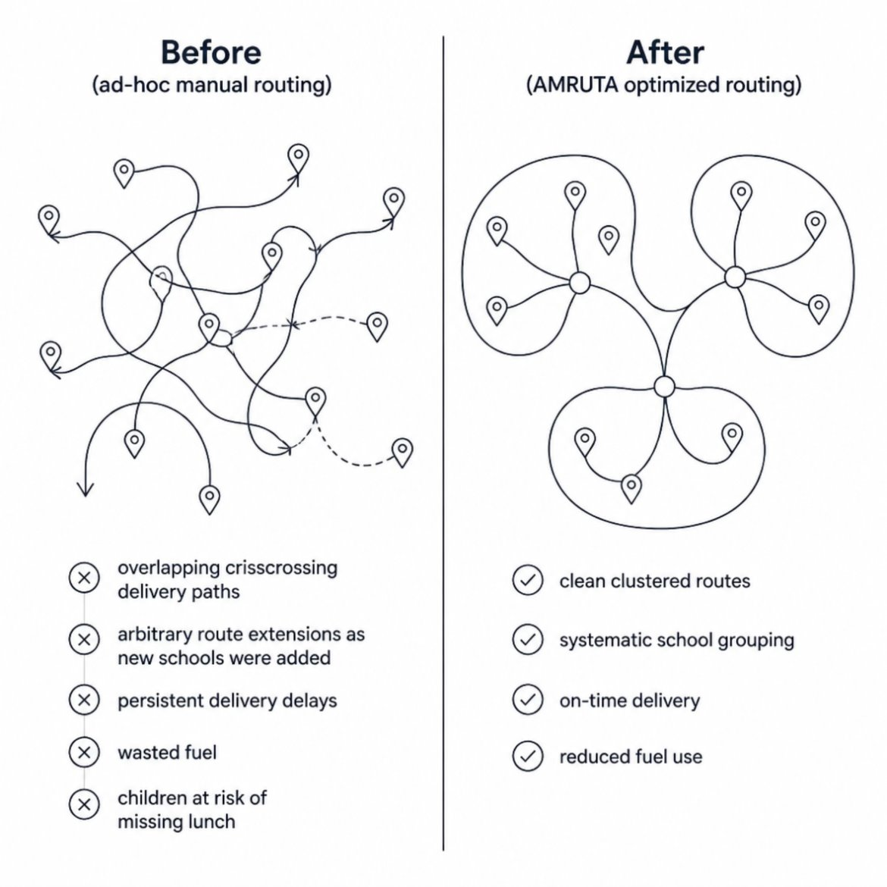
9.1 · COMPARING THE BENEFITS
What was wrong with the earlier planning process?
No formal logistics-planning method existed — routes grew ad hoc as new schools were added, one at a time, over many years.
Ad-Hoc Manual Routing
✕
Previous planning was entirely manual & lacked any optimization logic.
Arbitrary Extensions & Overlapping Paths
Whenever new schools were added in program, drivers simply extended the earlier routes arbitrarily. This created a tangled map of crisscrossing paths across the city.
✕
Wasted Resources & Delays
1,400 km of total daily travel, taking over 5 hours to complete. This inefficiency led to wasted fuel on redundant driving and persistent delivery delays that put the children at risk of missing their only meal of the day
Akshaya Patra · AMRUTA case study
11
Notes:
"Before the AMRUTA model, the foundation had no formal logistics-planning method. As new schools were added over the years, the routing process was entirely manual and lacked any underlying optimization logic.
Whenever a new school joined the program, drivers would simply extend their existing routes arbitrarily. This created a messy, tangled map of overlapping and crisscrossing paths across the city, which you can see in the 'Before' diagram on the left side of the screen.
This ad-hoc approach was incredibly inefficient, forcing the fleet to travel 1,400 kilometers every day and taking over 5 hours to complete deliveries. Ultimately, this wasted fuel on redundant driving and caused persistent delivery delays, putting the children at serious risk of missing their only meal of the day."

Slide 12
9.2 · COMPARING THE BENEFITS
How did decisions improve after AMRUTA?
35 → 27
1,400 → 1,325 km
> 5 hrs → 4 hrs
18.6%
75,000$ annually
vehicles deployed
(−23%)
daily trip length
(−443 L diesel/mo.)
total delivery
duration
monthly operating
cost reduction
Systematic Logic over Guesswork
Projected at national scale
Replaced arbitrary route extensions with the AMRUTA mathematical heuristic.
Assigns right-sized vehicles based on exact food capacity and computes the shortest delivery sequence.Data-Driven Trade-Offs
~US$1.96 million/year once AMRUTA is deployed across all 19 kitchens
Enough to extend the midday meal to ≈62,000 more children nationally, at prevailing costs
TAPF's own verification letter confirms the financial figures align with its internal estimates
Data-Driven Trade-Offs
Provides managers the flexibility to review alternative fleet configurations (e.g., comparing a 20-vehicle plan to a 27-vehicle plan).
Akshaya Patra · AMRUTA case study
12
Notes:
"So, what were the actual results after implementing AMRUTA at the pilot kitchen?
The hard numbers speak for themselves. They were able to reduce their active fleet from 35 vehicles down to 27. They eliminated 75 kilometers of unnecessary driving every day, and cut total delivery times from over 5 hours down to just 4 hours. This meant lower fuel consumption and guaranteed on-time lunches.
Overall, this generated an 18.6% reduction in monthly operating costs, translating to $75,000 in annual savings just from this one kitchen. More importantly, the new system transformed how decisions were made. Instead of guesswork, managers now relied on systematic logic to assign the right trucks, and they had the flexibility to make data-driven trade-offs between cost and delivery speed.
And the most exciting part? When projected at a national scale across all 19 kitchens, this optimization could save nearly $1.96 million a year—enough redirected capital to feed an additional 62,000 children every single day."

Slide 13
10 · LIMITATIONS
Limitations of the model and method
Euclidean Distance Approximation
Distance is an approximated Euclidean measure with a road/traffic “correction factor,” not true live road-network routing.
Single-Depot
Doesn't allow adjacent kitchens to share border schools.
Deterministic
It assumes travel times are fixed and doesn't account for random Bangalore traffic jams or truck breakdowns.
Sub-Optimal
Because it uses heuristics (shortcuts) rather than exact math, it doesn't guarantee the absolute "perfect" mathematical route.
“All models are imperfect” — AMRUTA's value lies in materially improving on an ad-hoc process, not in claiming provable optimality.
Akshaya Patra · AMRUTA case study
13
Notes:
While the results of this project were massive, it is important to acknowledge the limitations of the AMRUTA model.
First, it relies on a Euclidean Distance Approximation. This means instead of using a true, live road-network map, it calculates straight-line distances and applies a manual road or traffic 'correction factor' to estimate the route.
Second, the model is completely deterministic. It assumes travel times are fixed and cannot dynamically account for real-world chaos, like unpredictable Bangalore traffic jams or sudden truck breakdowns.
Third is the Single-Depot constraint. The system only optimizes for one central kitchen at a time, meaning it doesn't allow adjacent kitchens to logically share deliveries for schools located on their borders.
Finally, as we discussed earlier, the solution is technically sub-optimal. Because the software relies on heuristics—or mathematical shortcuts—instead of exact math, it cannot guarantee the absolute 'perfect' mathematical route.
However, as the slide notes at the bottom, 'All models are imperfect'. The true real-world value of AMRUTA isn't in proving mathematical perfection, but in taking a highly inefficient, ad-hoc process and making it materially better."

Slide 14
11 · CONCLUSION
OR turns an ad-hoc problem into a manageable, scalable solution
A modest, well-scoped heuristic (clustering + assignment + routing) — not an exact solver — was enough to deliver large, verified real-world savings.
Cost savings converted directly into social impact: thousands more children fed for the same budget.
Giving managers a range of solutions, not one “take-it-or-leave-it” answer, was as important to adoption as the algorithm itself.
The approach generalises to any perishable-goods distribution problem with a fixed fleet and strict time windows — e.g., food & beverage distribution.
Akshaya Patra · AMRUTA case study
14

